Slide 1

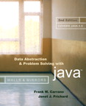
Chapter 7 (continued)
Stacks

Slide 2

Comparing Implementations
All of the three implementations are ultimately array based or reference based
Fixed size versus dynamic size
  An array-based implementation
    Uses fixed-sized arrays
      Prevents the push operation from adding an item to the stack if the stack’s size limit has been reached
  A reference-based implementation
    Does not put a limit on the size of the stack

Slide 3
Comparing Implementations
An implementation that uses a linked list versus one that uses a reference-based implementation of the ADT list
  Linked list approach
    More efficient
  ADT list approach
    Reuses an already implemented class
      Much simpler to write
      Saves time

Slide 4
The Java Collections Framework Class Stack
JCF contains an implementation of a stack class called Stack (generic)
Derived from Vector
Includes methods: peek, pop, push, and search
search returns the 1-based position of an object on the stack

Slide 5
Application:
Algebraic Expressions
When the ADT stack is used to solve a problem, the use of the ADT’s operations should not depend on its implementation
To evaluate an infix expressions
  Convert the infix expression to postfix form
  Evaluate the postfix expression

Slide 6
Evaluating Postfix Expressions
A postfix calculator
  Requires you to enter postfix expressions
    Example: 2, 3, 4, +, *
  When an operand is entered, the calculator
    Pushes it onto a stack
  When an operator is entered, the calculator
    Applies it to the top two operands of the stack
    Pops the operands from the stack
    Pushes the result of the operation on the stack

Slide 7
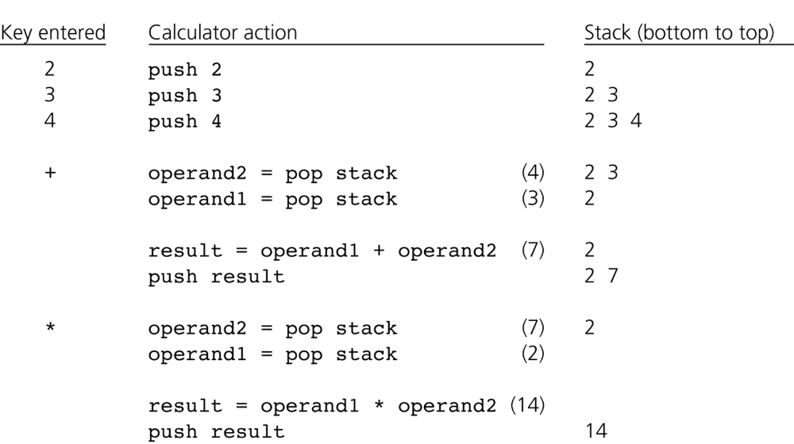
Evaluating Postfix Expressions
Figure 7-8
The action of a postfix calculator when evaluating the expression 2 * (3 + 4)

Slide 8
Evaluating Postfix Expressions
To evaluate a postfix expression which is entered as a string of characters
  Simplifying assumptions
    The string is a syntactically correct postfix expression
    No unary operators are present
    No exponentiation operators are present
    Operands are single lowercase letters that represent integer values

Slide 9
Converting Infix Expressions to Equivalent Postfix Expressions
An infix expression can be evaluated by first being converted into an equivalent postfix expression
Facts about converting from infix to postfix
  Operands always stay in the same order with respect to one another
  An operator will move only “to the right” with respect to the operands
  All parentheses are removed

Slide 10
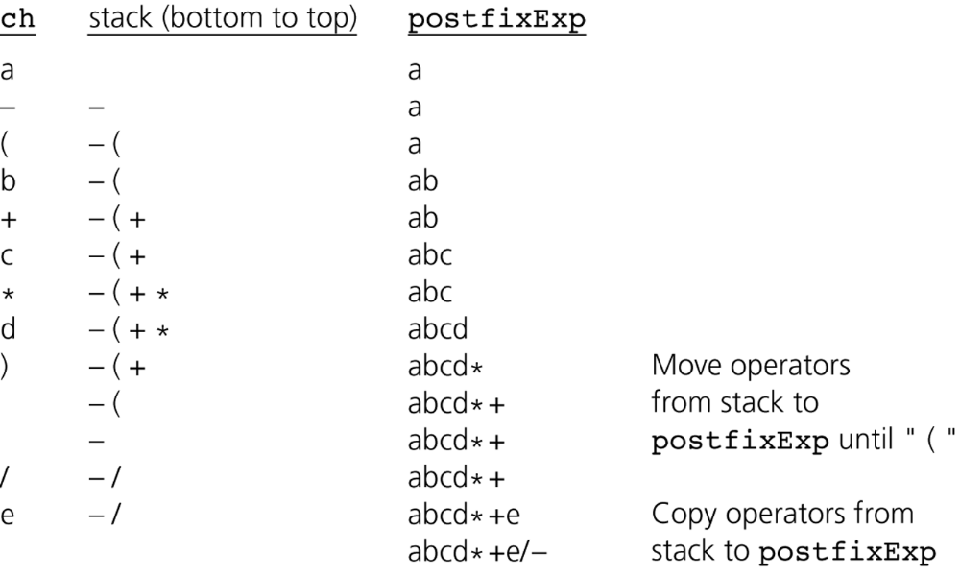
Converting Infix Expressions to Equivalent Postfix Expressions
Figure 7-9
A trace of the algorithm that converts the infix expression a - (b + c * d)/e to postfix form

Slide 11
Application: A Search Problem
High Planes Airline Company (HPAir)
  Problem
    For each customer request, indicate whether a sequence of HPAir flights exists from the origin city to the destination city

Slide 12
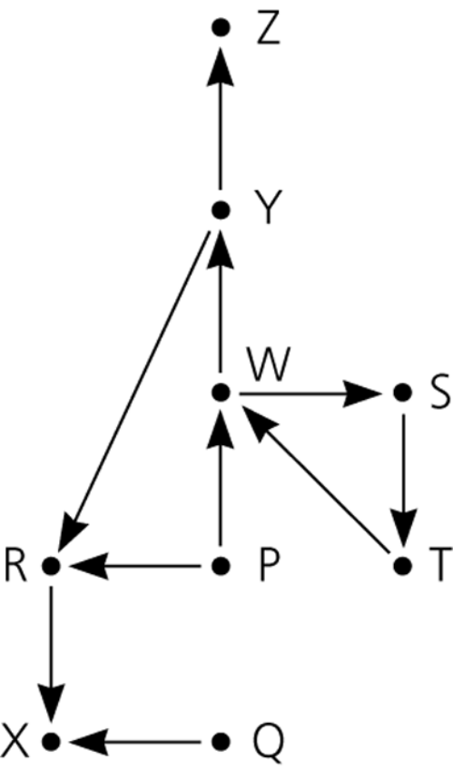
Representing the Flight Data
The flight map for HPAir is a graph
  Adjacent vertices
    Two vertices that are joined by an edge
  Directed path
    A sequence of directed edges
Figure 7-10
Flight map for HPAir

Slide 13
A Nonrecursive Solution that Uses a Stack
The solution performs an exhaustive search
  Beginning at the origin city, the solution will try every possible sequence of flights until either
    It finds a sequence that gets to the destination city
    It determines that no such sequence exists
The ADT stack is useful in organizing an exhaustive search
Backtracking can be used to recover from a wrong choice of a city

Slide 14
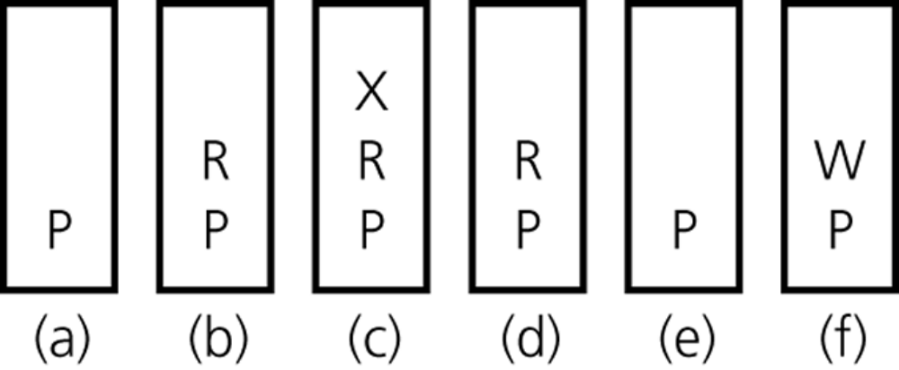
A Nonrecursive Solution that Uses a Stack
Figure 7-11
The stack of cities as you travel a) from P; b) to R; c) to X; d) back to R; e) back to P; f) to W

Slide 15
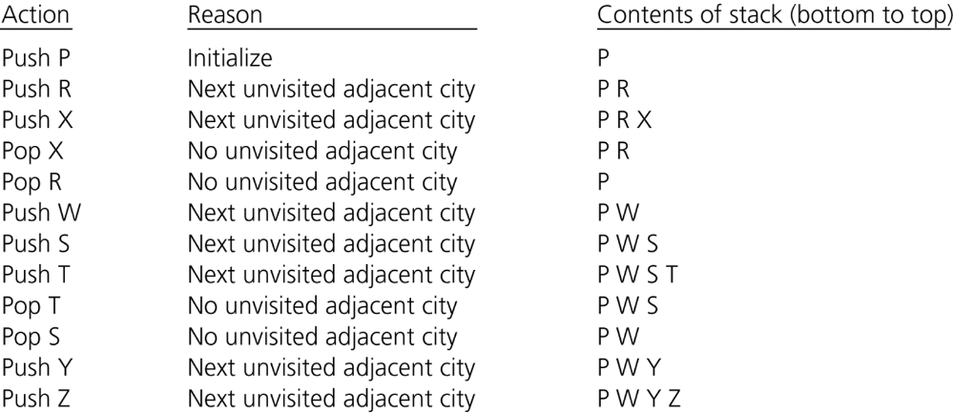
A Nonrecursive Solution that Uses a Stack
Figure 7-13
A trace of the search algorithm, given the flight map in Figure 6-9

Slide 16
A Recursive Solution
Possible outcomes of the recursive search strategy
  You eventually reach the destination city and can conclude that it is possible to fly from the origin to the destination
  You reach a city C from which there are no departing flights
  You go around in circles

Slide 17
A Recursive Solution
A refined recursive search strategy
  searchR(originCity, destinationCity)
  Mark originCity as visited
  if (originCity is destinationCity) {
  Terminate -- the destination is reached
  }
  else {
  for (each unvisited city C adjacent to originCity) {
  searchR(C, destinationCity)
  }
  }

Slide 18
The Relationship Between Stacks and Recursion
The ADT stack has a hidden presence in the concept of recursion
Typically, stacks are used by compilers to implement recursive methods
  During execution, each recursive call generates an activation record that is pushed onto a stack
Stacks can be used to implement a nonrecursive version of a recursive algorithm

Slide 19
Summary
ADT stack operations have a last-in, first-out (LIFO) behavior
Algorithms that operate on algebraic expressions are an important application of stacks
A stack can be used to determine whether a sequence of flights exists between two cities
A strong relationship exists between recursion and stacks

